Slide 1
Week 9
Tables joins, ui/ux and where to go next for sql

Slide 2
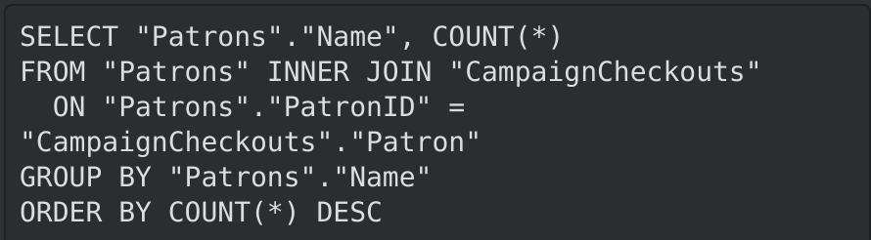
Why do we have so many table join types
Tables will have different relationships
The results of the different joins will show combinations of data
Depending on the problem we're trying to solve with our query we might need different combos of the data
For example, maybe we want to see the winner of a reading campaign. If we have a table of library patrons who signed up, and a table of books checked out for the campaign, we can do an inner join on them to see who the winner of the campaign is by ordering the results by descending(desc)

Slide 3
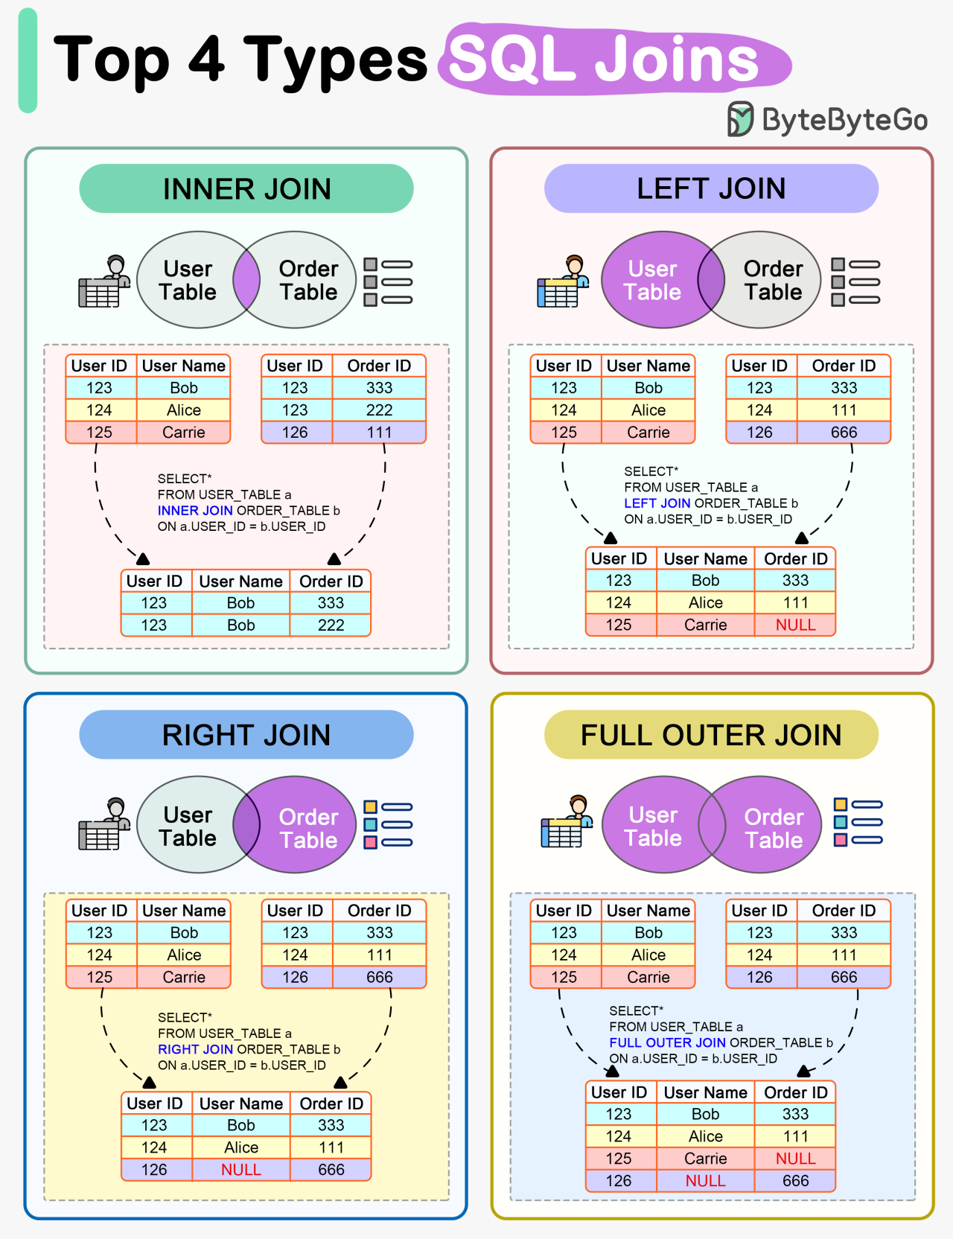

Visual of the types
http://www.differencebetween.net/technology/software-technology/difference-between-join-and-inner-join/
https://blog.bytebytego.com/p/ep90-how-do-sql-joins-work

Slide 4
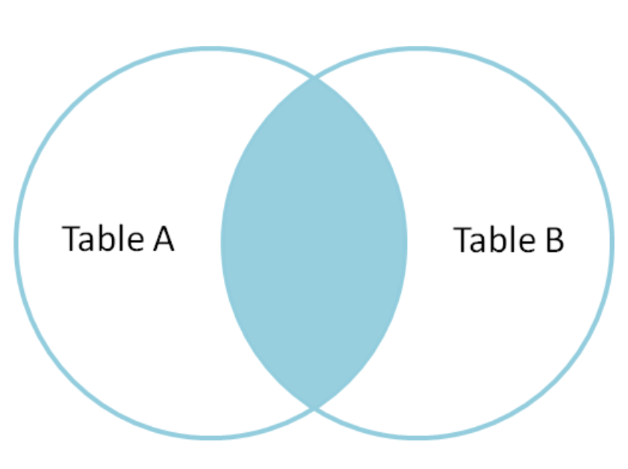
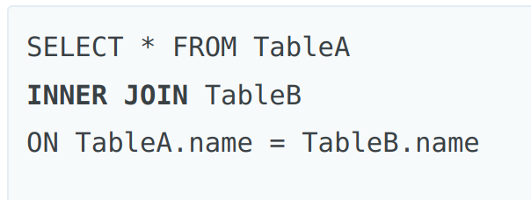
Inner Join
Tables have columns of information you need to know the names of the columns so that you can figure out what needs to match for the join
An Inner Join is going to be where the information on tables A and B match looking at a particular column
This is ONLY where they match
In this case we are looking at the column name in both tables A and B called name
Use case examples:
If we wanted to know patrons of the library who borrowed books in the last 6 months we would look at where patron's table and the books checkouts tables as seen in the example query on slide 1
https://blog.codinghorror.com/a-visual-explanation-of-sql-joins/

Slide 5
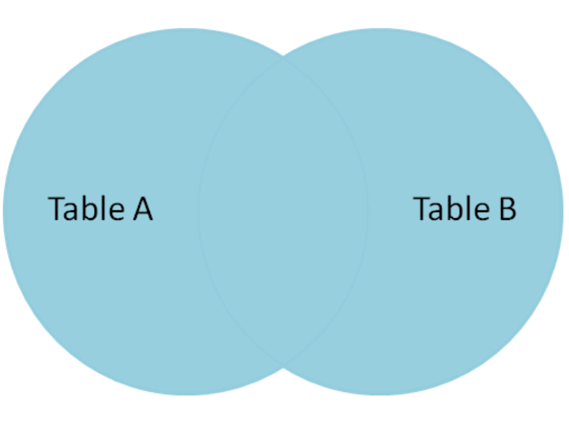
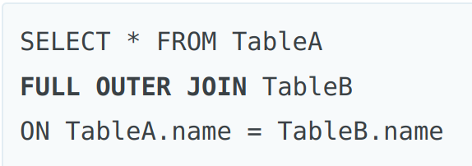
Outer Join
Tables have columns of information you need to know the names of the columns so that you can figure out what needs to match for the join
An Outer Join is all information in both tables including where they match
In this case we are looking at the column name in both tables A and B
This is less common then inner joins
Use case examples:
We can take a books table and a patrons table and look at both, not all books have been checked out, not all patrons have borrowed a book, but we want all the data anyway, anything not filled in will have a NULL value
https://blog.codinghorror.com/a-visual-explanation-of-sql-joins/

Slide 6
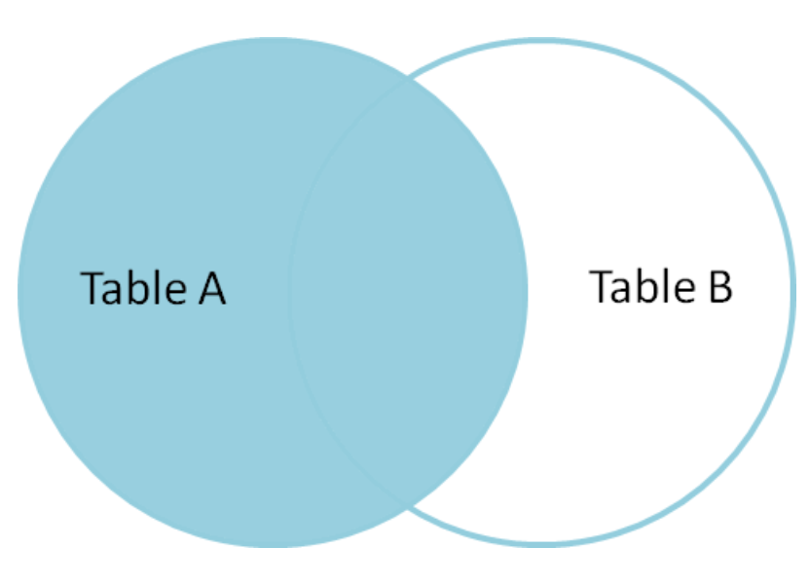
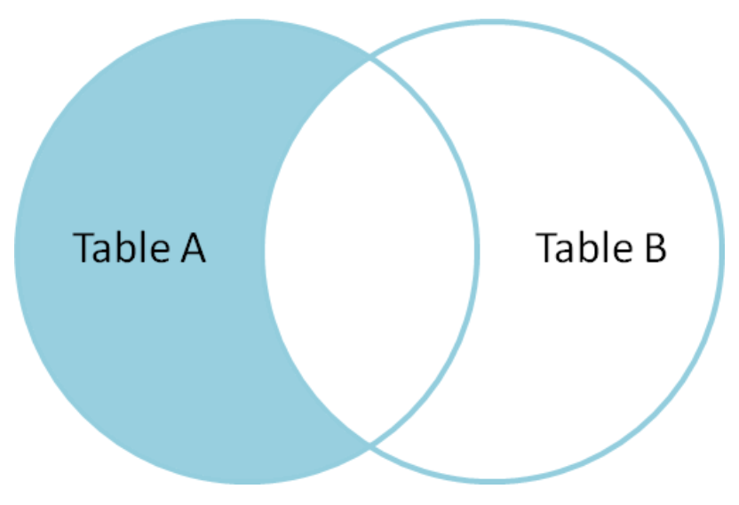
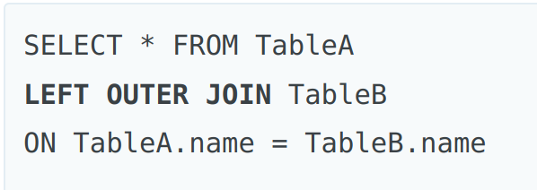
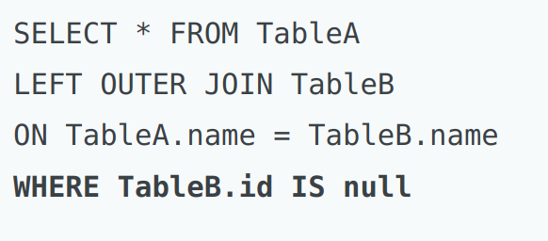
Left and Right Joins
Left Outer Join is all results from Table A including where there are matches on Table B
Left Outer join where we won't have the matches from Table B is done by using the WHERE to specify that if Table A has matches in Table B mark it as null in our results
We can do the same for the right with Right Outer Join by switching the order of the tables in the query
https://blog.codinghorror.com/a-visual-explanation-of-sql-joins/

Slide 7
Where to go next for more SQL
There are places you can go to get case studies to trial your SQL knowledge
https://8weeksqlchallenge.com/case-study-1/
https://advancedsqlpuzzles.com/
https://www.hackerrank.com/domains/sql
There are references you can look at
https://www.w3schools.com/sql/sql_quickref.asp
There are cheat sheets you can use for refresh
https://web.archive.org/web/20240119141821/https://learnsql.com/blog/sql-basics-cheat-sheet/#inner-join

Slide 8
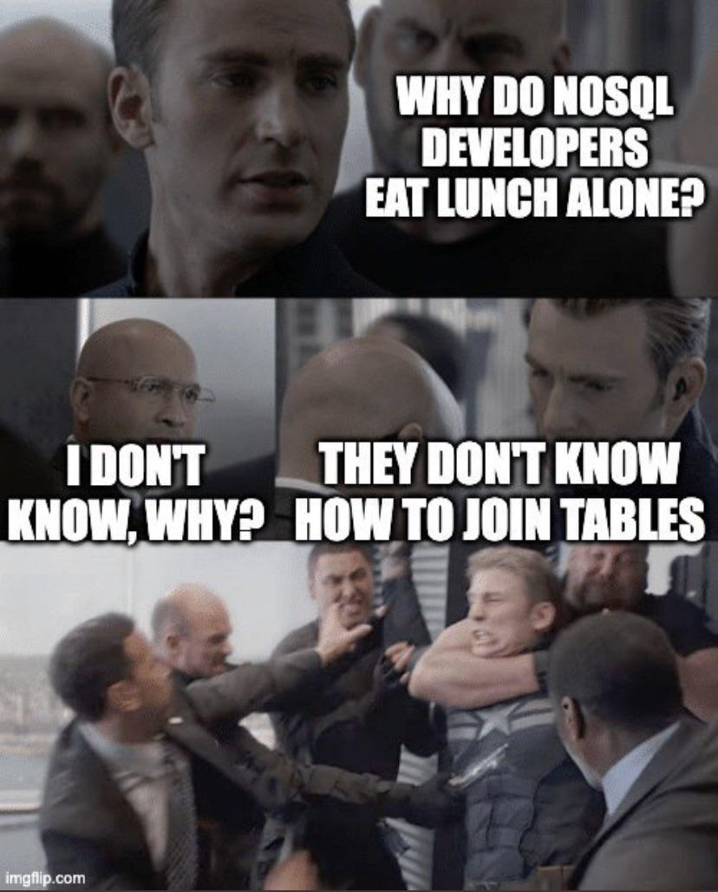
NoSQL
NoSQL stands for Not Only SQL
NoSQL databases are not relational
Examples of NoSQL databases are document, key-value, graph, or wide-column stores
Many people argue NoSQL is more flexible and scalable then SQL based Databases
NoSQL can handle unstructured and semi-structured data
Examples of implementations are MongoDB, Redis and Cassandra
An example of where you might want to use NoSQL instead of SQL might be if you wanted a database of images or videos (Large Items)

Slide 9


What is UI/UX
UI is User Interface
UX is User Experience
Both are topics that can be an entire course or job
UI/UX is how we interact with software, data or other things
UI is the look and feel of the interaction
UX is the overall experience

Slide 10
Why UI/UX is important
It's important to be able to communicate your information to others
If people don't want to use your software or interact with your data it doesn't matter how good your data is, or how important your analytics are
If others can't follow what you're doing with your data or product they won't know how to interact with it and will miss the things you want them to see, or not realize what you are trying to focus on
Reasonable or not people, tend to judge credibility by useability, if your data is hard to understand or present, people may not think it's credible

Slide 11
Ways we can communicate our data with others
We can generate reports of our data, for example PostgreSQL can generate a CSV for results of a query
Query results can also be sent to other programs if they are hooked into the database
Dashboards can be an example of a way to interact with a database
Business Intelligence (BI) tools can be used to create a data analysis report with charts, tables, filters, and parameters.
You can also put your query results on a website, such as when you search stores for items, a lot of stores use databases to keep track of their inventory, and your search is creating a query

